Slide 1
EMPLOYEE MANAGEMENT SYSTEM
BY,
P.SWETHA
P.NIVETHApalani
D.MAYTHILI
J.SUMITHA
A.SHEFA BANU

Slide 2
OBJECTIVE
This software application stores all the employee’s information in a database .
It contains employee information like employee id, first name, surname, and age.
It is an easy to use application and has a user-friendly interface. It is totally built at the administrative end which means that only the admin has access rights to change or modify any records.

Slide 3
System Requirements
Software requirements:
Mysql - 8.0
Hibernate tools(Indigo) - 3.4.x
Spring tools4(aka spring tool suite4) - 4.16.1.Release

Slide 4
Existing System:
Earlier system were manual where there was no way of properly storing information.
Employee records were stored manually which lead to errors.
It was very difficult and required a lot of paperwork which makes the application time-consuming and not secured.

Slide 5
Proposed System
Employee information system is easy to use applications which is created to manage the employee data.
It is created to record the details of the employees.
This reduces the dependency on the manual system which could create errors. This system can easily help in tracking employee records.

Slide 6
Modules
Register module: This module is used for the new employee where he or she can register themselves and get their login details.
Login modules: This module is created for login details of admin and the employee .There are different login details provided and both can login using their using their respective user id and password.
Manage employee module: This module enables admin to add and edit employee records. It is also for viewing the each and every employee details by the admin.

Slide 7
Benefits
Efficiency and better accuracy.
Boosted profitability,.
Reduce Manual Errors
Higher productivity.
Lower costs.
Data security.
Increased employee engagement.

Slide 8
Advantage
Manage employees effectively.
Productive
Engaged and Happy.
provide seamless working experience.
With convenient automation and centralized data.

Slide 9
Mysql
Mysql provides connectivity for client applications developed in the java programming language with Mysql connector
Mysql is a Relational database management system (RDBMS) that offers a variety of features ,including .it allows us to use rows, columns ,and indexes .
Implements the java database connectivity (JDBC)API, as well as a number of value- adding extension of it.

Slide 10
Hibernate Framework:
Hiberanate is a framework that simplifies the development of java application to interact with the database.
It is an open source ,lightweight,ORM(object Relational Mapping)tool.
Hibernate implements the specifications of JPA(java persistence API) for data persistence.

Slide 11
Spring Framework:
The spring framework(spring) is an open source application frame work that provides infrastructure support for developing java applications.
One of the most popular Java Enterprise Edition (Java EE) frameworks
spring helps developers create high performing applications using plain old java objects(POJOs).

Slide 12
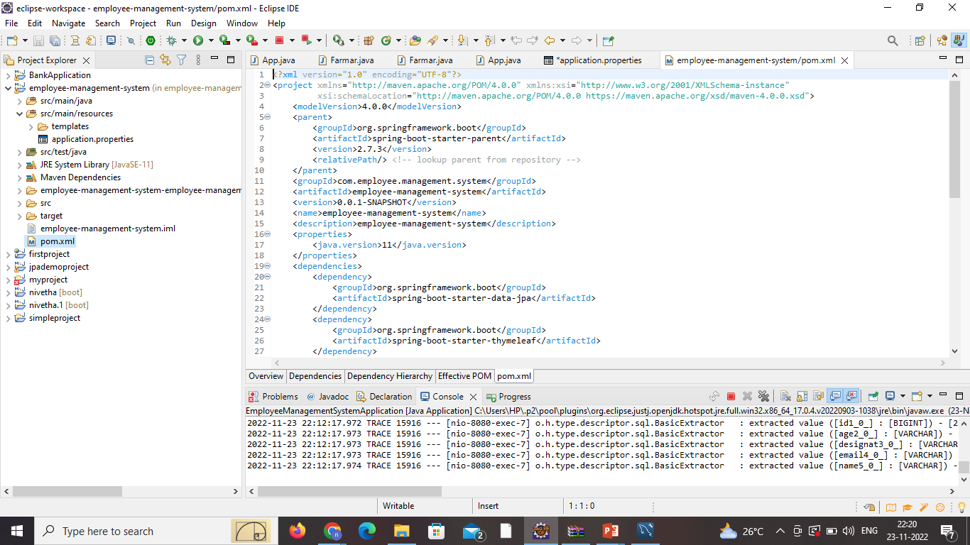
Coding

Slide 13
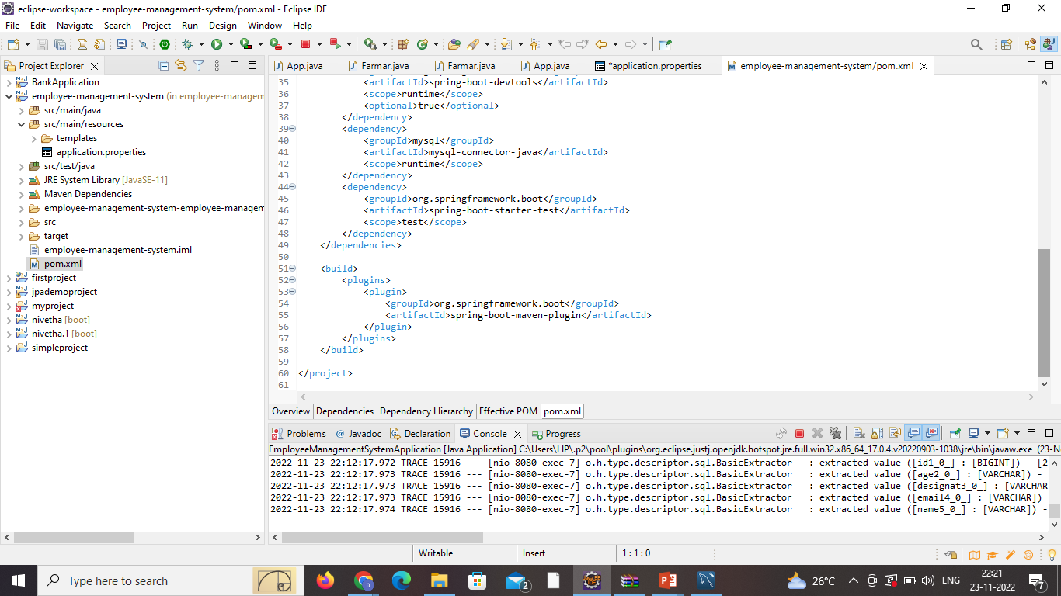

Slide 14
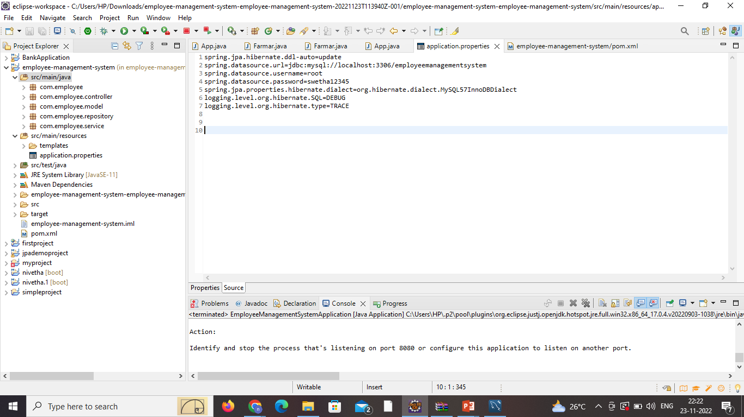

Slide 15
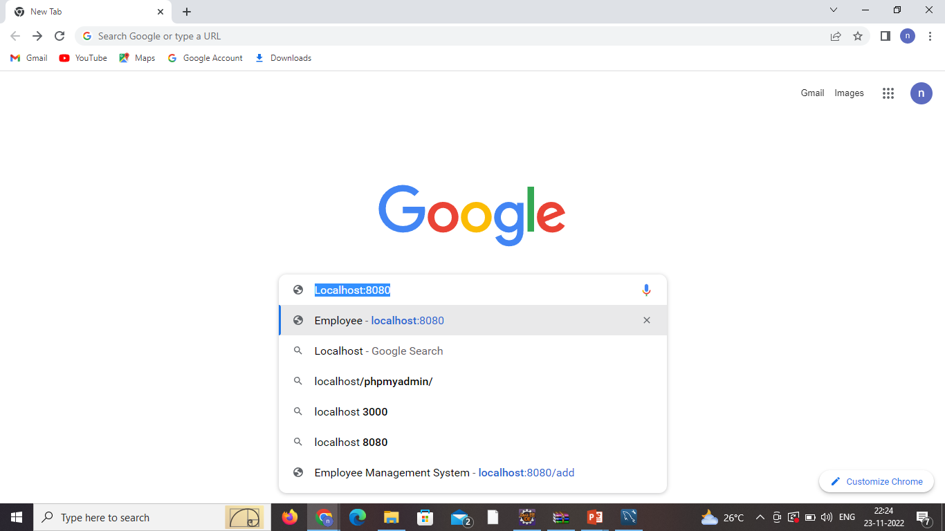

Slide 16
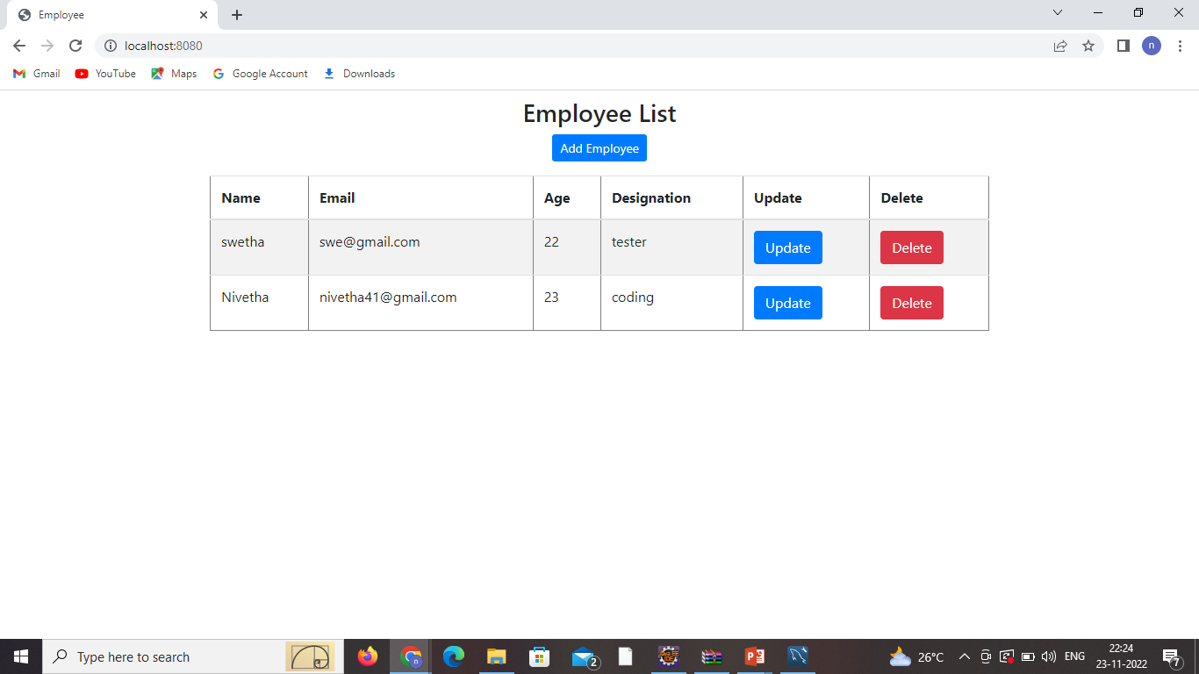
Output Add Employee

Slide 17
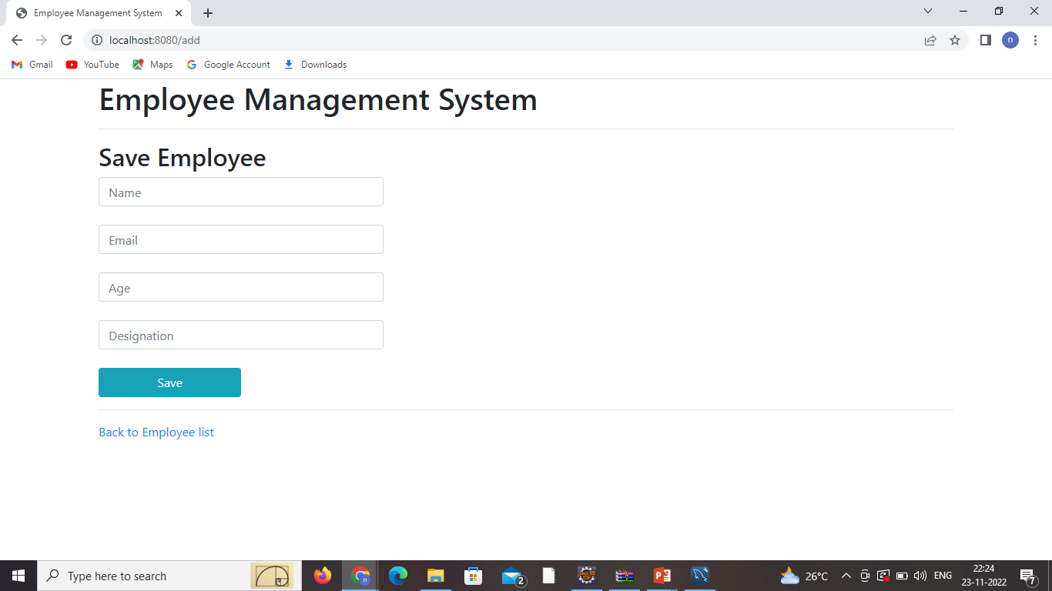

Slide 18
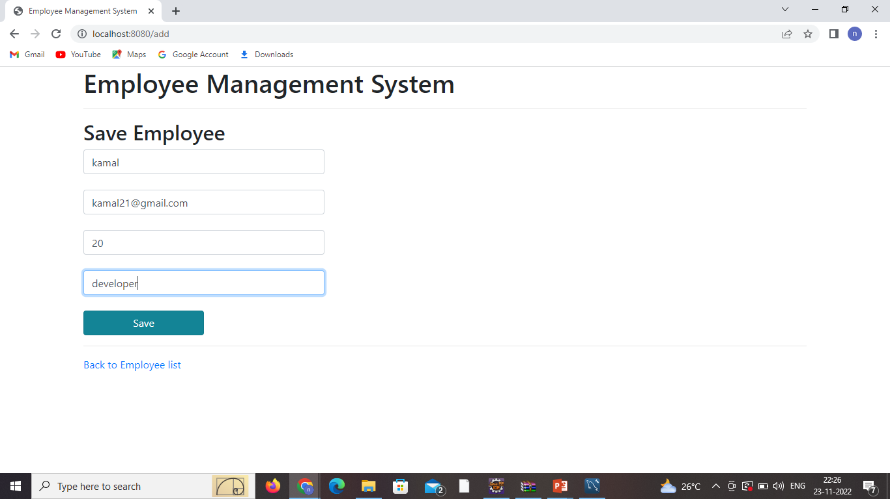

Slide 19
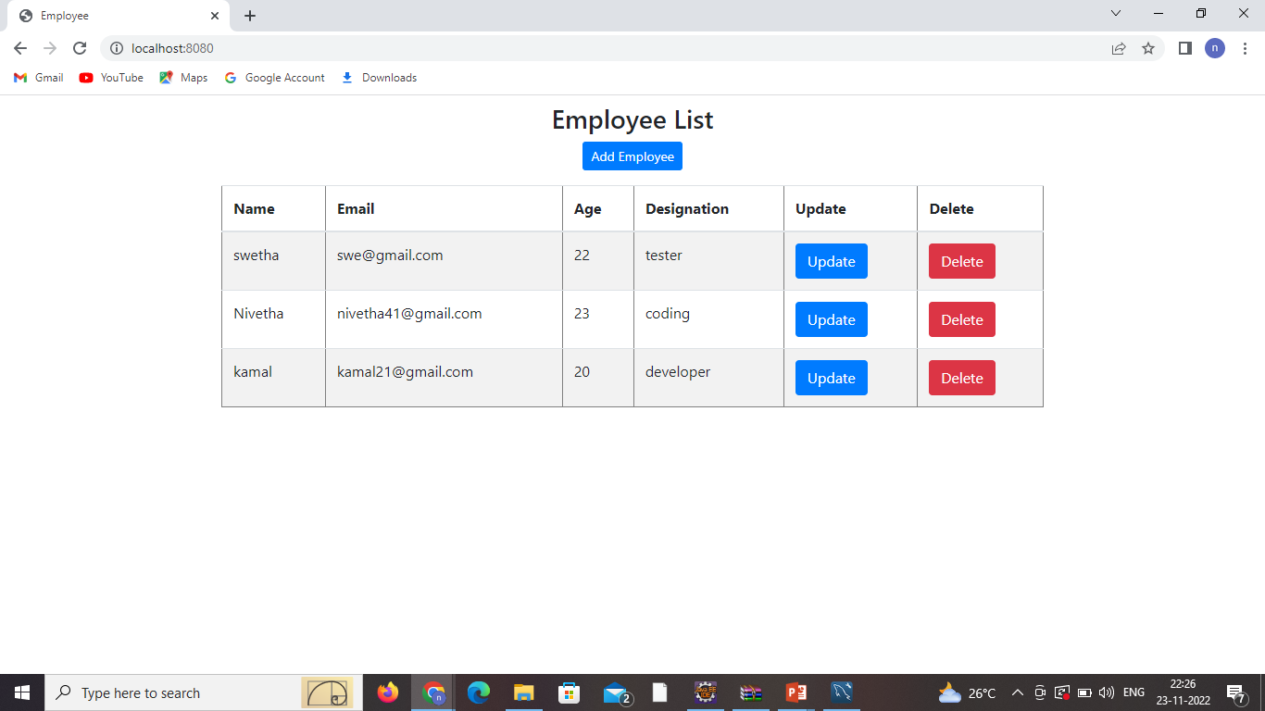

Slide 20
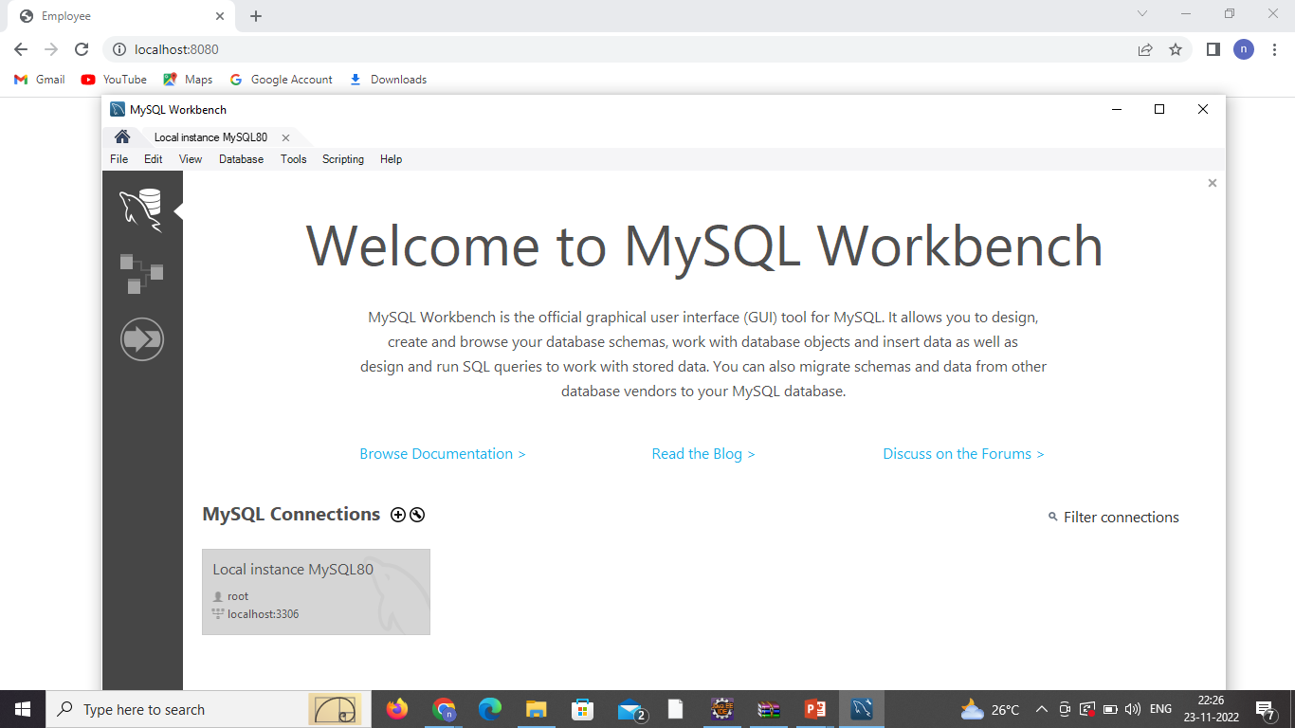

Slide 21
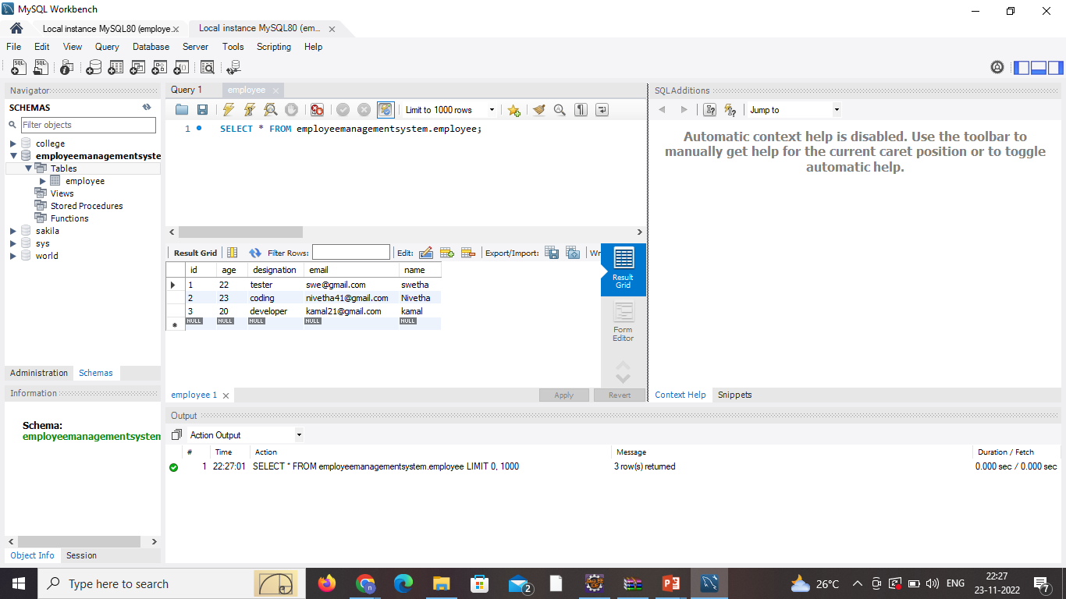

Slide 22

Update Employee

Slide 23


Slide 24


Slide 25
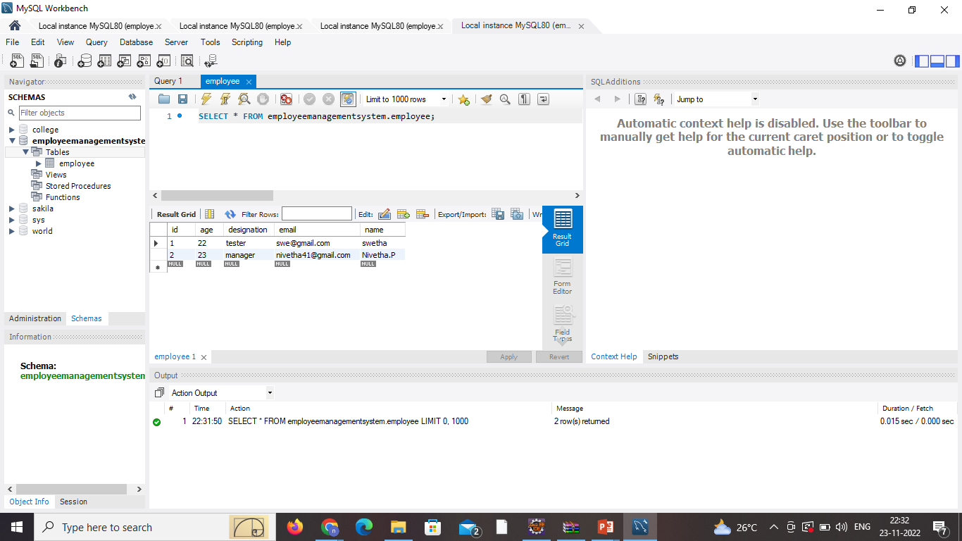

Slide 26
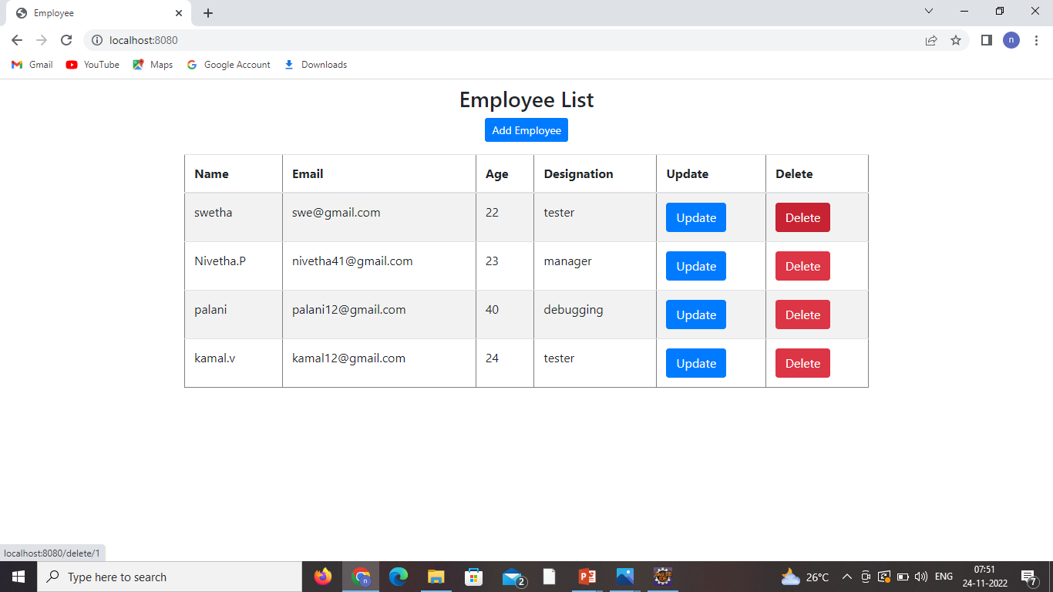
Delete Employee

Slide 27


Slide 28
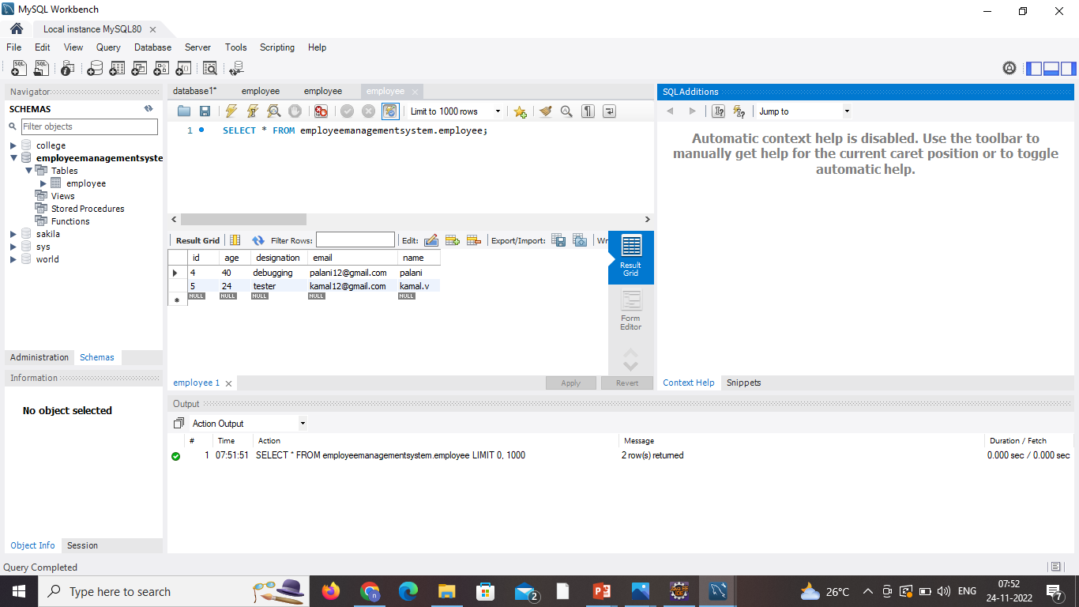

Slide 29
Conclusion
In this report an information system’s development has been presented.
As a future work, some additional stuff could be implemented and integrated into the application code making it much more reliable and flexible ; especially what concerns payroll module , for instance.
Apparently, the role of such systems is basic and essential within each company that wants to keep a really good control and record concerning its personnel data, functionality and performance on all levels in its structure.

Slide 30
THANK YOU

